Slide 1
Azure Storage
Microsoft Research

Slide 2
Azure Storage
Blobs
Storage for any type of data, analogous to files in a file system, with individual blobs storing up to 1 TB of data
Queues
Reliable messaging for workflow processing and for communication between applications or application components
Tables
NoSQL storage of semi-structured data for rapid development and fast access to large quantities of data
Files
File sharing using Server Message Block (SMB) protocol

Slide 3
Blob Storage
Accounts
Containers
Blobs
images
schema.jpg
a4rlabs
Png/flow.png
documents
Labs.pdf
3 to 24 characters
0-9 and a-z
Unique within Azure
3 to 63 characters
0-9, a-z, and dashes
1 to 1,024 characters
Any characters (including slashes)
URL characters must be escaped
Max. 254 path segments

Slide 4
Blob URLs
Accounts
Containers
Blobs
images
schema.jpg
a4rlabs
Png/flow.png
documents
Labs.pdf
https://a4rlabs.blob.core.windows.net/images/schema.jpg

Slide 5
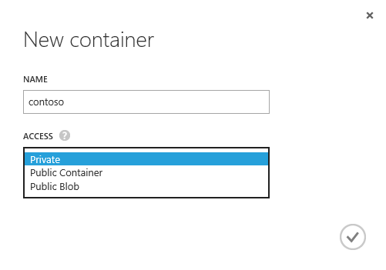
Access Policies
Each container is assigned one of three access policies
Private – Blobs can't be read or enumerated anonymously
Public Container – Blobs can be read and enumerated anonymously
Public Blob – Blobs can be read anonymously, but cannot be enumerated
Notes:
One way to share information (blobs) with other researchers is to put the blobs you wish to share in a public container. But those blobs truly are public and can be accessed by anyone who knows their URLs.

Slide 6
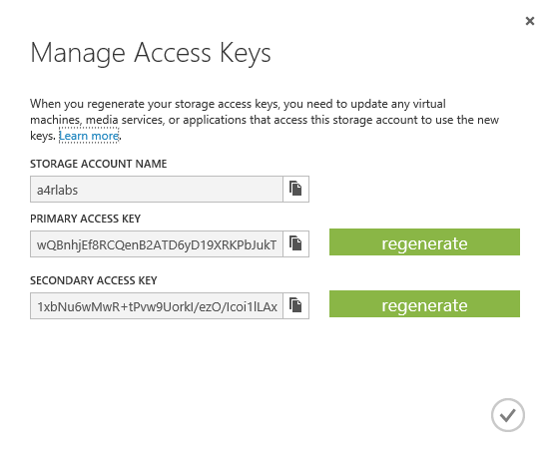
Access Keys
Access to storage by non-account-owners relies on keys for authentication
Two 512-bit keys per account
Keys should be "rolled" periodically for security
Keys can be used to generate shared-access signatures (SAS) for secure and restricted access
Notes:
Access keys should never be handed out to other people because they provide unlimited access to a storage account. SAS tokens are safer because they can be time-limited and set to provide read-only access. The best way to generate a SAS token is with Microsoft's cross-platform Azure Storage Explorer.

Slide 7
Using a Shared-Access Signature
Blob URL
https://a4rlabs.blob.core.windows.net/images/schema.jpg?
st=2016-02-07T19%3A58%3A00Z&se=2016-02-08T19%3A58%3A00Z&sp=r&sv=2015-02-21&sr=b&sig=BGebg1eduvPTwQnZWZlBphM8YGP9sRYt2WiPIL70vcw%3D
Query string containing
shared-access signature

Slide 8
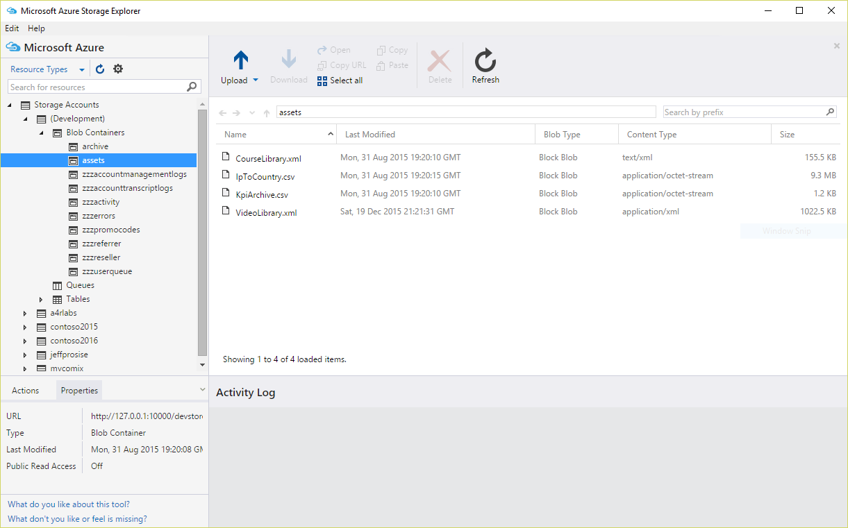
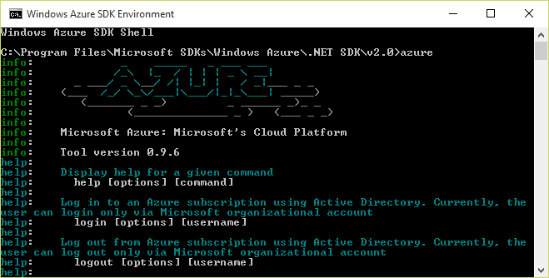
Azure Storage Tools
Portal doesn't provide functionality for uploading blobs or generating shared-access signatures
Use free, third-party, cross-platform tools instead
Microsoft Azure Storage Explorer
Azure Command-Line Interface (CLI)
Notes:
The Microsoft Azure Storage Explorer provides an easy-to-use GUI interface for creating containers, uploading and downloading blobs, generating SAS tokens, and more. But if you want to use a scripting language such as Bash or PowerShell to script storage operations, the Azure CLI is the way to go.

Slide 9
Hands-On Lab
Using Azure Storage
Azure Storage HOL.html

